Slide 1
Heat and Mass balance Introduction
Technical Development Program SPREAD 2016

Slide 2
Objectives/ Scope of a heat and mass balance
Objectives
Determination of the actual heat consumption
Heat Consumption = Energy from Fuels / Clinker produced
Verification of clinker production (kiln feed / clinker factor)
Assessment of kiln and cooler performance
Trend data and chemical data will be additionally used
Quantification of gas, energy and material flows
Basis for upgrades of equipment
Scope
Mass balance of entire kiln system
Air balance of cooler
Heat balance of cooler (cooler efficiency)
Heat balance of entire kiln system

Slide 3
Basic principle
Under stable conditions :
Mass _{input} = Mass _{output}
Energy _{input} = Energy _{output}

Slide 4
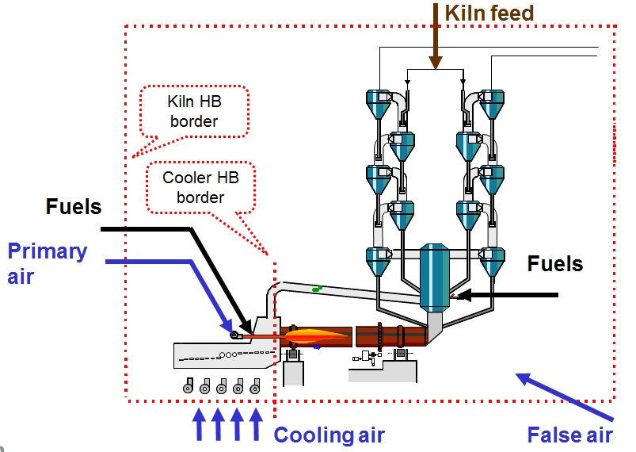
Heat and mass balance inputs

Slide 5
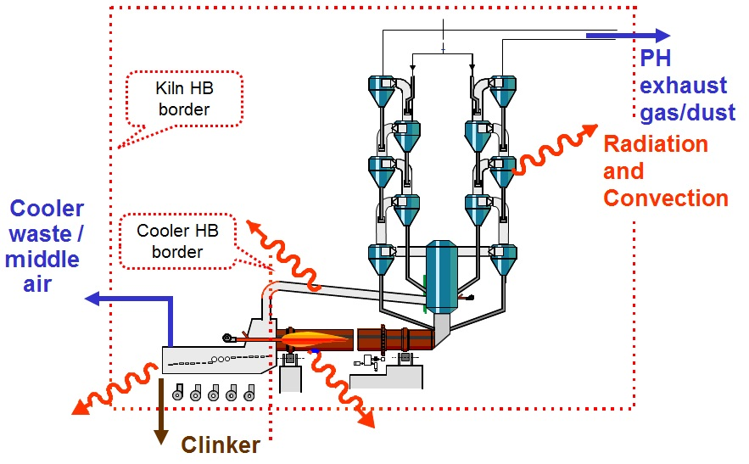
Heat and mass balance outputs

Slide 6
Heat and mass balance
Energy inputs and outputs (related to 1 kg cli & 20 °C)
Energy from sensible heat [kg / kg _{cli}]
Solid (kiln feed, clinker, dust, fuel ashes)
Liquid (fuels, kiln feed moisture, water injected)
Gaseous (air, exhaust gas, water vapor)
Energy of chemical / physical reactions [kJ / kg _{cli}]
Energy from fuels, combustible matter in kiln feed and in exhaust gases
Energy for chemical reactions (clinker formation)
Water evaporation
Radiation and convection losses

Slide 7
Heat and mass balance
Mass inputs and outputs (related to 1 kg cli & 20 °C)
Solid mass flows [kg / kg _{cli}]
Kiln feed, clinker, dust (exhaust gas, bypass), fuel ashes
Liquid mass flows [kg / kg _{cli}]
Fuels, moisture of kiln feed, water injected
Gaseous mass flows [Nm³ / kg _{cli}]
Air (cooling air, primary air, false air, cooler waste air)
Exhaust gas
Bypass gas

Slide 8
Preparatory works
Definition of fuels, kiln feed chemical setpoints
Calibration of all feeding devices
Instrumentation check
Prepare logistics of weight out
Plan raw mill runtime
Ensure availability of measuring points
Switch all PID loops of kiln in automatic mode (especially cooler fans, kiln hood pressure and main filter fan)
Plan measurement schedule and teams

Slide 9
Manual measurements required
Necessary on the H&M balance day:
Ambient conditions (humidity from weather station nearby)
Clinker mass flow
Clinker temperature (incl. coating / lumps)
Radiation and convection losses
Primary air temperature
If applicable:
Bypass dust rate and properties / bypass gas flow and temperature
Cooler middle air flow and temperature
Water flow and temperature of injection into cooler/ preheater
Cross-checks possible before H&M balance day: (averages from TIS during balance)
Kiln feed rate and properties
Gas properties at PH outlet
ILC only: Gas properties at kiln inlet
Tertiary air temperature
Fuel rates and properties
Cooler fan flow and temperature
Cooler waste air temperature
Carried out before H&M balance day:
Kiln dust loss rate and properties
Total primary air flow (if no burner adjustments done)

Slide 10

Samples and analysis required
Kiln feed (every 2 – 4 h)
LOI, moisture, (main oxides)
Kiln dust during direct operation (2 – 3 samples)
LOI, moisture, (main oxides)
Hot meal (every 3 – 4h)
LOI (for calculation of degree of decarbonization)
Fuels (every 1 – 4 h)
Moisture, ash, NCV (!) (main oxides)
Approx formula:
Clinker
(main oxides)

